Slide 1
Retrieving Duplicate Issue Reports with Deep Image Understanding
Integrating Visual and Textual Semantics Using Deep Learning
Does including images (screenshots) as an additional source of information improve duplicate bug report detection in Android applications?
Mustahid Hasan

Slide 2
Outlines
Background
Challenges & Related Work
Motivations: Integrating Visual and Textual Semantics using DL
Proposed method
Evaluation
Conclusion

Slide 3
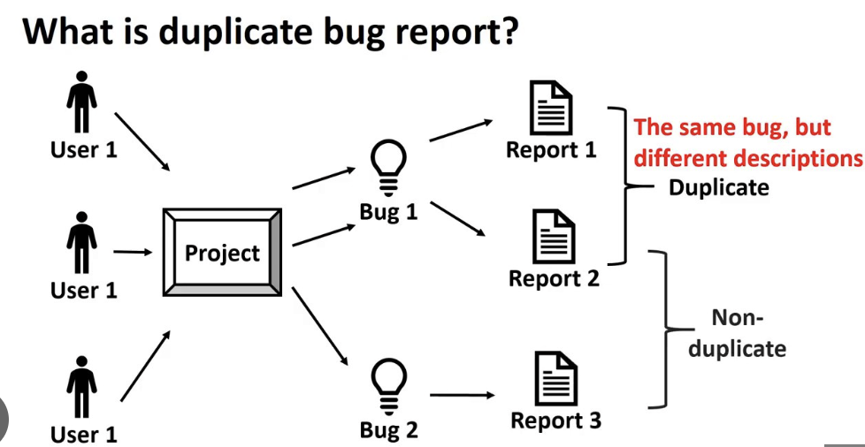
Background
Mobile app testing tasks are distributed to crowdsourcing testers
Crowdsourced testing leads to the significant issue of duplicate crowdsourced test reports (GitHub, Jira, Bugzilla).
Data suggests that an average of 82% of crowdsourced issue reports in actual industrial data are duplicates.
Triagers spend 20-30% of time identifying duplicates
This high duplication rate greatly reduces the review efficiency of software developers and hinders the timely resolution of bugs
The issue report corpus of duplicates and non-duplicates is substantially different, making the task technically more challenging.
Traditional Approach
- Manual inspection by developers
- Keyword-based search
- Text similarity measures (TF-IDF, BM25)

Slide 4
Challenges & Related Work
Most existing SOTA methods rely heavily on unsupervised clustering of textual features.
While some related work explores GUI image understanding, many GUI components lack natural language labels, to predict these labels based on images.
Some approaches relied on extracting textual features and using shallow image analysis of unsupervised learning.
Lack of semantic relationships between screenshots and textual descriptions may lead to the imprecise analysis of issue reports.
Study lacks whether integrating issue report’s image can help or not increasing the accuracy of duplicate Issue Report detection.
Notes:
ˌkrɑːnəˈlɑːdʒɪk(ə)

Slide 5
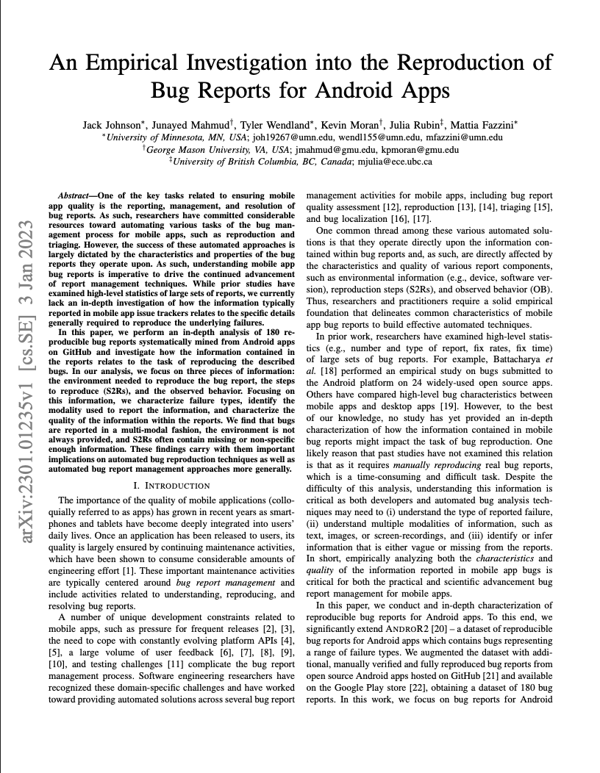
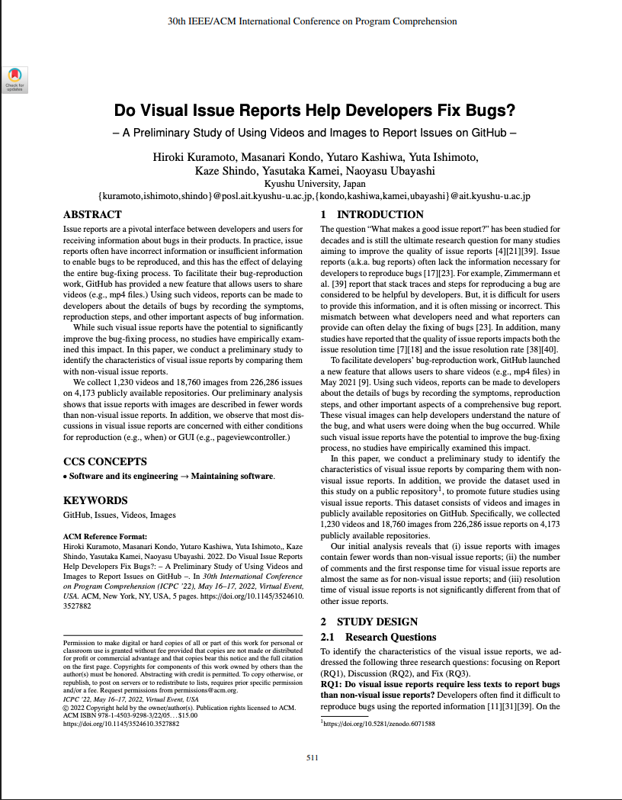
Challenges & Related Work
Notes:
ˌkrɑːnəˈlɑːdʒɪk(ə)

Slide 6
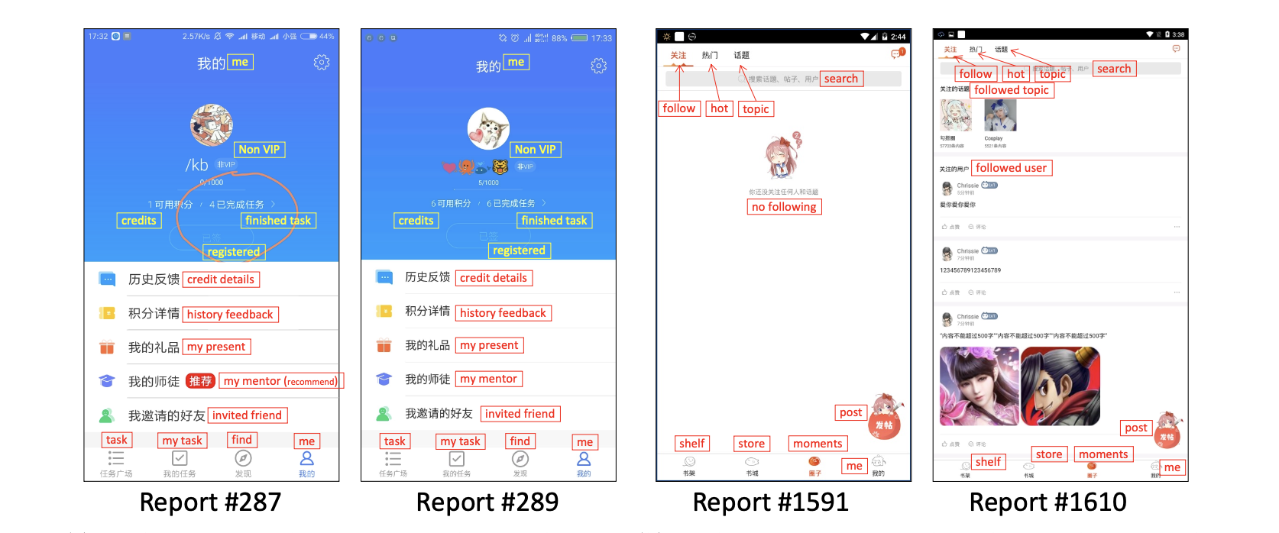
Motivations
Example of Duplicate Reports
[4]
a) Different Textual Descriptions for Similar App Screenshots b) Different App Screenshots for Similar Textual Descriptions
Report #287 : Click on the “me” button, the actual “finished task” number should be 0 instead of 4. The result is different from expectation.
Report #289: Click to accept the task, and choose to view unfinished tasks, while it shows finished tasks under the avatar.
Report #1591: Choose one topic to follow, contents will not appear until the app is refreshed.
Report #1610: Choose moments and follow two topics, while the app does not show the content, contents can be seen after refreshing.

Slide 7
Motivations
Example of Duplicate Reports
Screenshots Provide:
1. UI State Information: Which screen was the user on?
2. Error Messages: Visual error dialogs captured
3. Context: Layout, widgets, visual elements
4. Reproduction Evidence: Step-by-step visual proof
Two bug reports with similar screenshots and similar text descriptions are more likely to be duplicates than reports matching on text alone.
H1: Multi-modal features (Visual + Textual) outperform single-modality approaches for duplicate bug report detection.

Slide 8
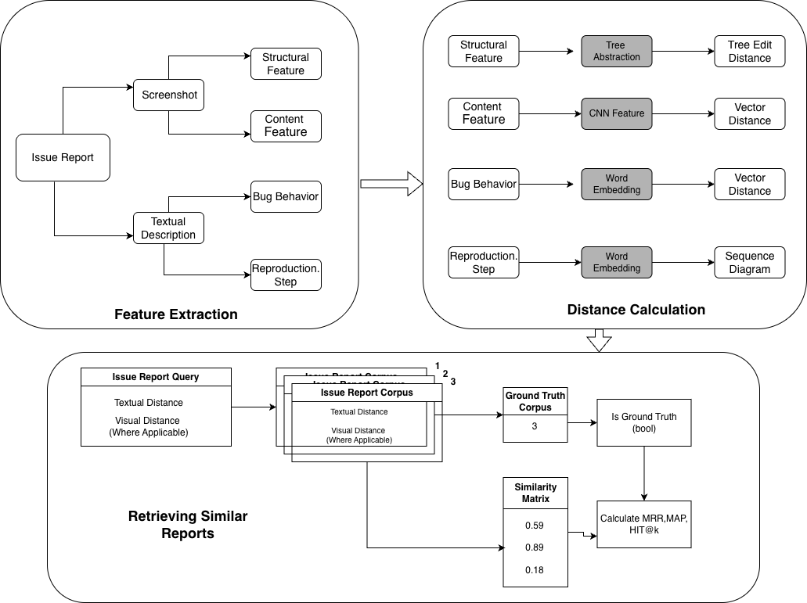
Proposed Method

Slide 9
Proposed Method
Feature Type | Source Component | Deep Learning Technique | Output
Structural Feature (SF) | Screenshot | Hybrid DL: Combines with VGG-16 and a CNN model (16 Layer of trainable Weights). | Four-level tree structure of widgets.
Content Feature (CF) | Screenshot | CNN Model: Trained on widget screenshots. AdaDelta optimizer and categorical_crossentropy loss function used during training. | 4096-dimensional vector (output of the penultimate fully connection layer, discarding SoftMax)
- Input: Bug report screenshots (resized to 224×224)
- Output: 512-dimensional feature vector per image
- Distance: L2-normalized Euclidean distance between feature vectors

Slide 10
Proposed Method
Feature Type | Source Component | Deep Learning Technique | Output
Bug Behavior (BB) | Textual Description | Pre-trained TextCNN model: Used to separate the Bug Behavior from the Reproduction Step.
Bug Behavior (Encoding) | Textual Description | Word2Vec model: To encode the Bug Behavior vector. | 100-dimensional vector.
Reproduction Step (RS) | Textual Description | Component parser algorithm analyzes part-of-speech to extract operations and objects. | Sequence of operations and objects (RS=⟨S1, S2,,...,Sn⟩).
TextCNN Classify sentences into:
- Bug Description (what went wrong)
- Reproduction Steps (how to trigger the bug)
Extract semantic embeddings for similarity computation

Slide 11
Proposed Method (Feature Distance Aggregation)
When Images Available
Similarity = (S_structure + S_vgg16 + S_text_problem + S_text_steps / 4)
When No Images Available
Similarity = (S_text_problem + S_text_steps / 2)
Normalization
All distances normalized to [0, 1] using min-max scaling:
normalized = (distance - min_distance) / (max_distance - min_distance

Slide 12
Dataset Description
Property | Filtered Subset | Full Dataset
Total Bug Reports (N) | ~600 | ~3,000
Query Reports (Q) | 125 | 2,323
Reports with Images | All queries | Mixed
Ground Truth Groups | Manually labeled | Manually labeled

Slide 13
Data Structure
Bug Report:
├── ID: Unique identifier
├── Description: Text content
├── Screenshots: Binary image data
├── UI Layout: XML structure
├── Repository: Source project
└── Ground Truth: Duplicate group ID
- Collected from Android open-source projects
- Time period: Year 1 corpus
- Parquet format for efficient storage

Slide 14
Retrieval Evaluation: Process & Metrics
We will iterate through each issue report, treating it as a query to calculate ranking quality:
Query: Each report ID in the dataset is selected as a query.
Rank: The Similarity Matrix is used to sort all other reports from most similar (lowest score) to least similar.
Compare: This ranked list is compared against the Ground Truth to identify known duplicates.
Aggregate: Scores (MRR, MAP, HITS@k) are calculated for each query and then averaged to produce the final, overall metrics.
Key Output Metrics
The final output is a set of numerical scores that quantify the system's ranking quality:
MRR (Mean Reciprocal Rank)
  What it is: Measures the average rank of the first correct duplicate.
  Example Value: 0.8333
MAP (Mean Average Precision)
  What it is: Rewards the system for ranking all true duplicates highly.
  Example Value: 0.7500
HITS@k
  What it is: The percentage of queries where a true duplicate is found within the top k results.
  Example Value: K= 1: 1.0000, K= 5: 1.0000

Slide 15
Retrieval Evaluation: Results
We iterate through each issue report, treating it as a query to calculate ranking quality:
Dataset | Queries | MRR | MAP | HITS@1 | HITS@5 | HITS@10
FILTERED | 125 | 0.1703 | 0.1647 | 10.40% | 20.80% | 32.80%
FULL | 2,323 | 0.0845 | 0.0731 | 4.74% | 9.73% | 14.59%

Slide 16
Retrieval Evaluation: Results (Experiment 2)
Experiment 2: Learned Feature Weights
Optimized Weights: BB=8.0, RS=0.5, SF=0.7, CF=0.3
Dataset | MRR | MAP | HITS@1 | HITS@5 | HITS@10 | Dataset
FILTERED (Weighted) | 0.1602 | 0.1495 | 8.06% | 18.55% | 36.29% | FILTERED (Weighted)
FULL (Weighted) | 0.0883 | 0.0685 | 5.10% | 10.30% | 15.25% | FULL (Weighted)

Slide 17
Observation & Interpretation
FILTERED dataset (image-only queries) performs 2 times better than FULL
HITS@10 = 32.80% means ~1/3 of duplicates found in top 10
Performance degrades significantly with larger corpus (FULL)
Including images does help but improvement is modest
VGG-16 ImageNet features may not transfer perfectly to UI screenshots
Simple averaging fusion may not capture cross-modal interactions and Feature weights improves retrieval results slightly.(~32% to ~36% for the Filtered dataset)

Slide 18
References
[1] J. Johnson, J. Mahmud, T. Wendland, K. Moran, J. Rubin, and M. Fazzini, "An Empirical Investigation into the Reproduction of Bug Reports for Android Apps," 2022 IEEE International Conference on Software Analysis, Evolution and Reengineering (SANER), Honolulu, HI, USA, 2022, pp. 321-322, doi: 10.1109/SANER53432.2022.00048.
[2] Hiroki Kuramoto, Masanari Kondo, Yutaro Kashiwa, Yuta Ishimoto, Kaze Shindo, Yasutaka Kamei, and Naoyasu Ubayashi. 2022. Do visual issue reports help developers fix bugs? A preliminary study of using videos and images to report issues on GitHub. In Proceedings of the 30th IEEE/ACM International Conference on Program Comprehension (ICPC '22)
[3] Junjie Wang, Mingyang Li, Song Wang, Tim Menzies, and Qing Wang. 2019. Images don’t lie: Duplicate crowdtesting
reports detection with screenshot information. Information and Software Technology 110 (2019), 139–155. https://doi.org/10.1016/J.INFSOF.2019.03.003
[4] Shengcheng Yu, Chunrong Fang, Quanjun Zhang, Mingzhe Du, Jia Liu, and Zhenyu Chen. 2024. Semi-
supervised Crowdsourced Test Report Clustering via Screenshot-Text Binding Rules. Proc. ACM Softw. Eng. 1,
FSE, Article 69 (July 2024), 24 pages. https://doi.org/10.1145/3660776

Slide 19

Thank you so much!!!

Slide 20
Appendix (Terminologies)
What is VGG-16?
    Deep Convolutional Neural Network (16 layers)
    Pre-trained on **ImageNet** (1.2M natural images, 1000 classes)
    Extracts hierarchical visual features
Architecture
Input Image (224×224×3)
↓
[Conv3-64] × 2 → MaxPool
↓
[Conv3-128] × 2 → MaxPool
↓
[Conv3-256] × 3 → MaxPool
↓
[Conv3-512] × 3 → MaxPool
↓
[Conv3-512] × 3 → MaxPool
↓
Feature Vector (512-dim)

Slide 21
Appendix (Terminologies)
    What is TextCNN?
    Convolutional Neural Network for text classification
    Captures n-gram patterns effectively
Architecture
Input: "App crashes on login button"
↓
Word Embeddings (Word2Vec 100-dim)
↓
┌──────┼──────┐
▼ ▼ ▼
Conv1D Conv1D Conv1D
(3-gram)(4-gram)(5-gram)
│ │ │
▼ ▼ ▼
MaxPool MaxPool MaxPool
└──────┼──────┘
▼
Fully Connected
↓
Classification:
[Bug Description | Reproduction Step]

Slide 22
Appendix (Terminologies)
    Word2Vec (Continuous Bag of Words)
    Learns dense vector representations of words
    Pre-trained on bug report corpus (100 dimensions)
    Captures semantic relationships: `crash ≈ terminate ≈ close`
Dynamic Time Warping (DTW)
- Measures similarity between sequences of reproduction steps
- Handles variable-length step lists
- Aligns steps optimally across two reports
Report A: [Step1, Step2, Step3]
Report B: [Step1, Step3, Step4, Step5]
↓
DTW finds optimal alignment → Distance score

Slide 23
Appendix (Terminologies)
UI Structure Similarity with APTED
What Are Structure Features?
- Android UI layouts represented as XML trees
- Capture hierarchical structure of screens
APTED Algorithm
- All Path Tree Edit Distance
- Computes minimum edit operations to transform one tree to another
- Operations: Insert, Delete, Rename nodes
Example
xml
<!-- Report A Layout --> <!-- Report B Layout -->
<LinearLayout> <LinearLayout>
<Button id="login"/> <Button id="login"/>
<TextView id="error"/> <ImageView id="logo"/>
<EditText id="password"/> <EditText id="password"/>
</LinearLayout> </LinearLayout>
Edit Distance = 2 (Delete TextView, Insert ImageView)

Slide 24
Experiments
The proposed method, was compared against one state-of-the-art (SOTA) baseline and three specific configurations (ablations) designed to verify the effectiveness of the deep features and the semi-supervised approach.
Baselines and Configurations | Publication Year | Role
SETU (Wang et al. (3)) | 2019 | State-of-the-Art (SOTA) comparison baseline.
Image | N/A | An ablation configuration using only image features (Structural Feature and Content Feature).
Text | N/A | An ablation configuration using only text features (Bug Behavior and Reproduction Step).
Empirically demonstrate whether including images as an additional source of information can/cannot enhance the process of retrieving similar issue reports.

